Slide 1

SEND Information Report
Gillingstool Primary School

Slide 2


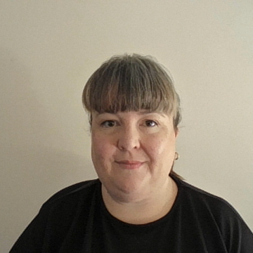
Section 1: Welcome and School Vision
Welcome
Roles and responsibilities
Mosaic Partnership Trust
Vision
Context

