Slide 1
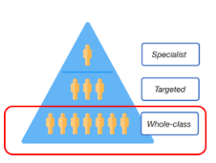


Section 4: Universal offer
Inclusive pedagogy
Adaptations to the curriculum and the learning environment
Whole class teaching that is accessible to all learners
SEND teaching that is built in not bolt on
Enabling classrooms
Promoting independence

