Slide 1
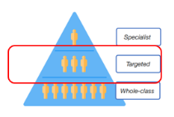


Section 5: Targeted support
Targeted support offer for the school
Short, regular and time limited interventions
Evidence informed and targeted interventions
Adult-led interventions delivered with fidelity.

