Slide 1

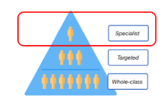
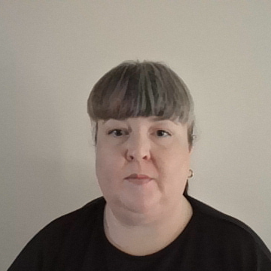
Section 6: Specialist support
Specialist support offer for the school
Training/ CPD for staff
Working in partnership with external services

