Slide 1

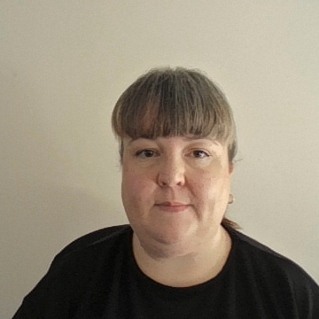
Section 10: Further information
The Local Authority’s Local Offer
SEND policy/medical policy/ behaviour policy
Accessibility

