Slide 1

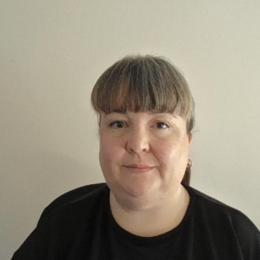
Section 9: Raising a concern/question
Who to contact
Complaints procedure
Tel: 01454 866527
Email: office@Gillingstool.org.uk

